Slide 1
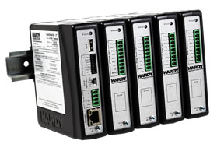
HI 6600 Instructions
Installing the HI 6600 into the CompactLogix System.
Notes:
This presentation will show installing the HI 6600 into the Compact Logix system, but this would apply to the Control Logix system as well. The installation is using RS Logix 5000 and the HI 6600 EDS_AOP.

Slide 2
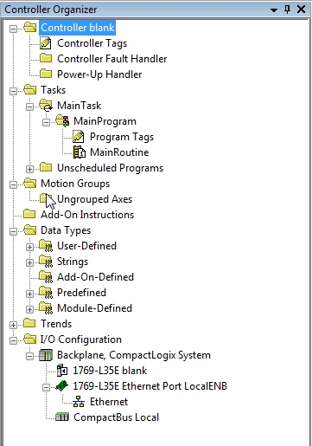
Project Organizer
Notes:
This is showing the project already started and my processor selected and installed. The user would need to start their own project with their processor selected and select their EtherNet I/P connection.

Slide 3
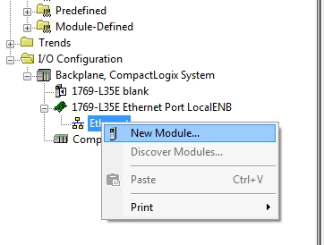
Adding the New Module
Notes:
On the EtherNet I/P in the I/O configuration, right click and select NEW MODULE.
This will allow you to select the type of module to install into the I/O configuration.

Slide 4
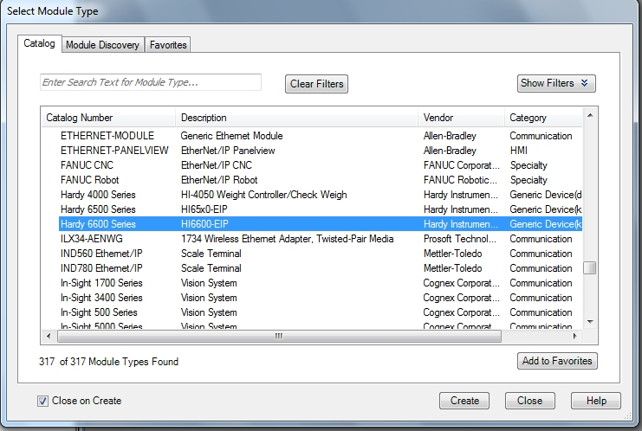
Select the Unit to Add
Notes:
In the catalog list, select the Hardy 6000 Series unit.

Slide 5
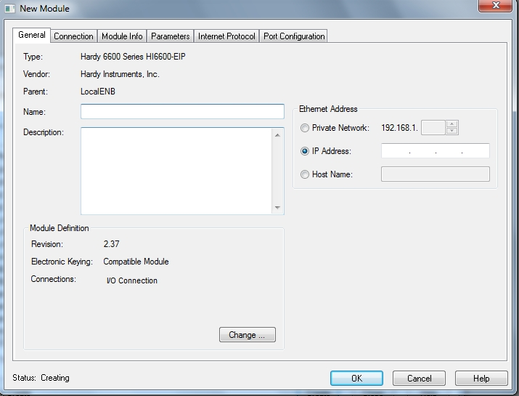
The New Module Dialog Box
Notes:
With the New Module dialog box, you will name and setup the module parameters. This will include the IP address of the module.

Slide 6
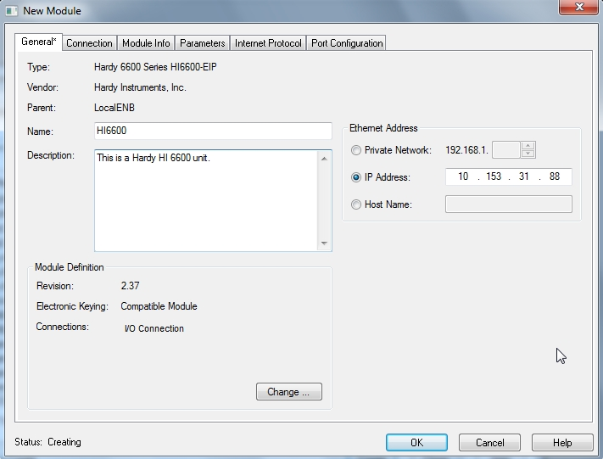
Describing the Module
Notes:
This shows a dialog box filled in with the name, description and the IP address of the unit.

Slide 7
Module I/O Controller Tags
Notes:
Once you have created and inserted the new module into the configuration table, the software will create the controller tags for the unit.
The controller tags are where you will read and write data to and from the module.

Slide 8
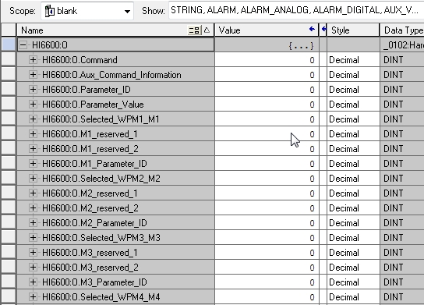
Controller Output Tag Expanded
Notes:
This is showing a partial image of the output controller tag. This demonstrates the labels for the registers.
NOTE the first four registers would be the Common Header section. This is where a command would be entered, and if needed, the parameter ID and new value to write to the parameter.
Notice the next registers are in four register blocks. This is where the user would enter the channel number (Selected_WPMx_Mx) for the channel they wish to read in that module of registers. If they wish to read an additional particular parameter for that channel, they would enter the parameter ID into the Mx_Parameter_ID register.

Slide 9
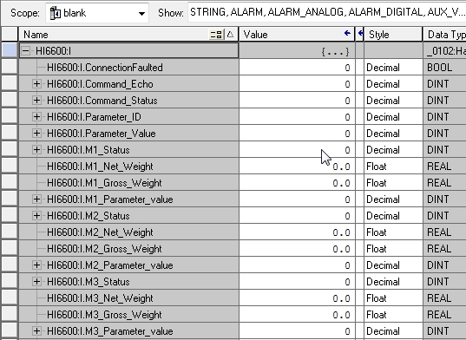
Controller Input Tag Expanded
Notes:
This is a partial shot of the input table controller tags. This demonstrates the labels to be found for the registers. This is showing the Common Header section, which is the first four registers. This is where the commands are sent to the Weight Processor Modules and where parameters can be set or read from the WPMs.
The next sections of the registers are for each module as defined as a channel. Each module section is four registers and is where you would see the channel status, Net weight, Gross weight and a user selected parameter value.
The channel being read is each section is defined by the entry made by the user in the Output Controller Tag.(noted in previous slide.
Every four registers would be a new set of registers for a defined module channel.

Slide 10
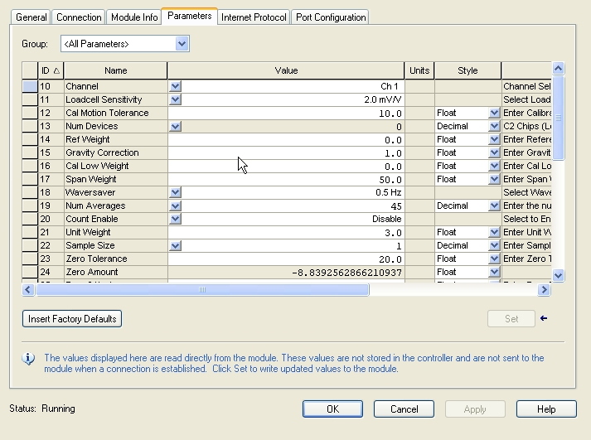
Parameters in the AOP
Notes:
Once the program has been downloaded to the processor, the dialog box can be opened for the module and on the Parameters tab you should then see a list of the parameters and their current values. These can be modified here.
There is a Group drop down list at the top of the page where the user can select a sub set of the total list. (next slide).
If the selection is “grayed” out, it is a read only parameter.

Slide 11
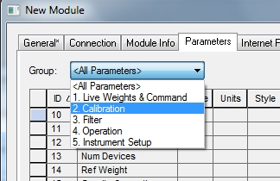
Group Selection
Notes:
Here we see the different group sub sets of the all parameters list.
Notice that first listing is for live weights and commands.

Slide 12
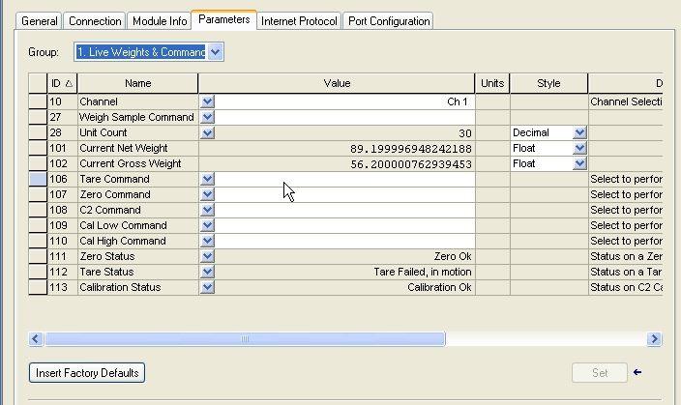
Live Weights & Commands
Notes:
Selecting the Live Weights and Commands Group, the user can then see the weight readings for the channel selected. This would be a live, real time reading.
Also notice the drop down selections for the commands and status of commands.

Slide 13
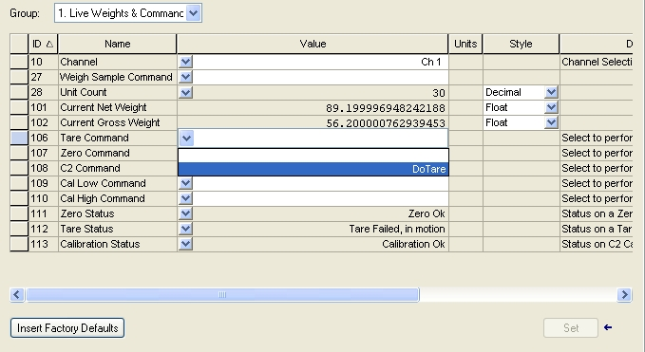
Example - Tare Command
Notes:
An example of running a command:
If we wish to run a Tare command, drop down the list for Tare command and select Do Tare.
Once the user makes this selection, they would need to click on the “SET” button to actually run the command.

Slide 14
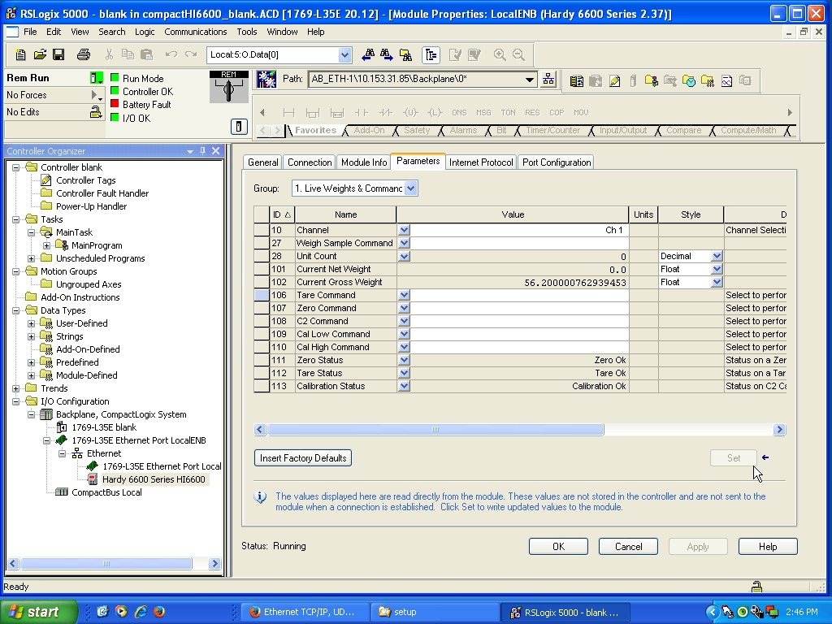
Results of Tare Command
Notes:
Once the “SET” button was triggered, you notice the Net weight went to zero and the Tare Status indicates the Tare is OK.

